Slide 1
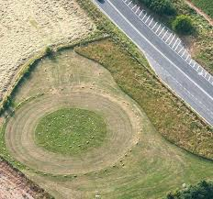
Avebury
Avebury is in the United Kingdom

Slide 2
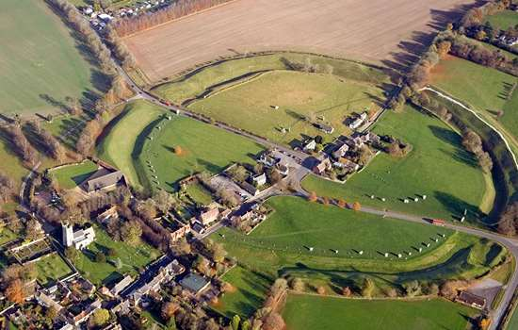
Avebury is a beautiful place to be and this is how it looks.
Picture of Avebury

Slide 3
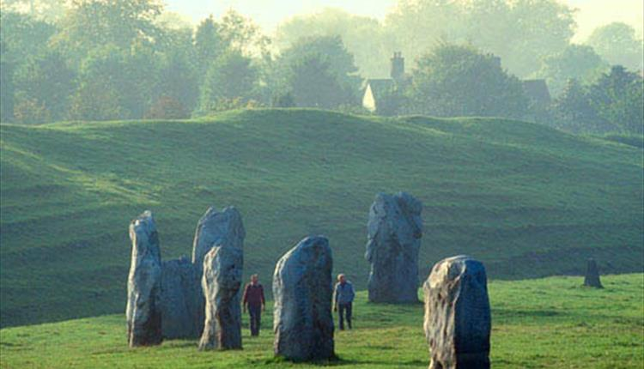
facts
Did you know that some of the rocks have disappeared through out the years .

Slide 4
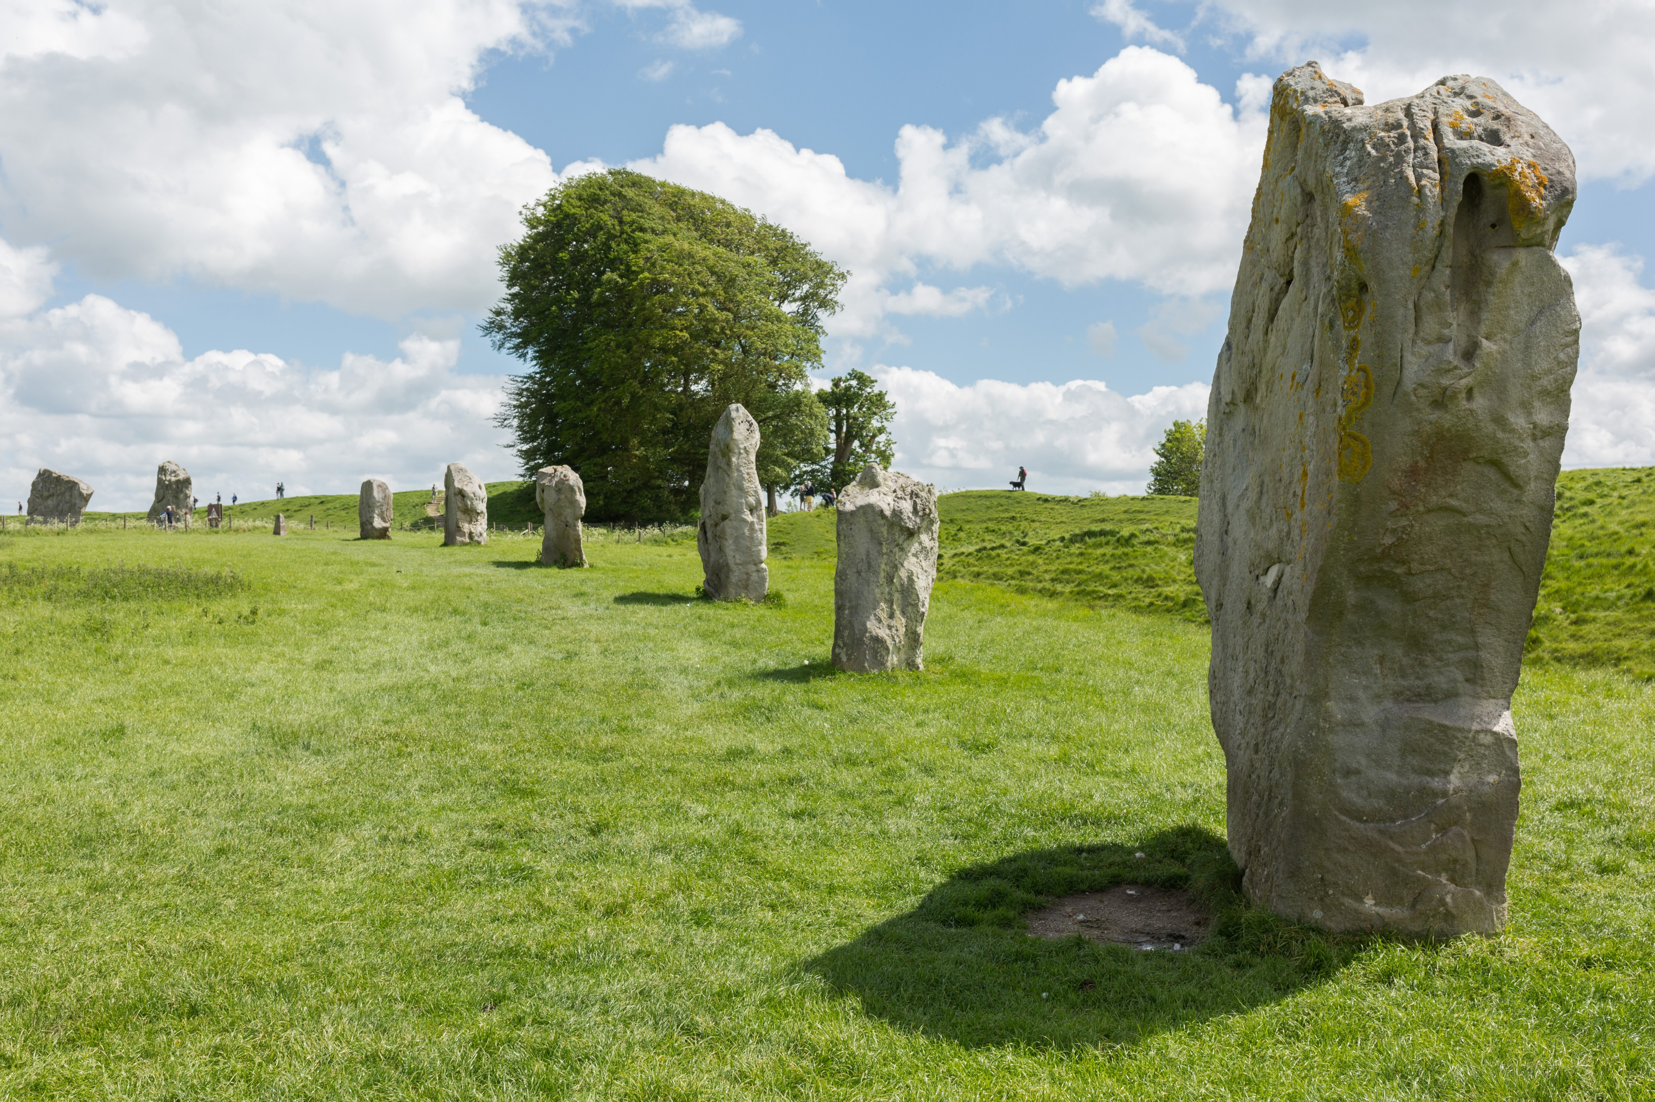
finally
Caveman worked hard to dig rocks from underground.

